Slide 1

Oracle series :
FUNCTION OVER()
Author: Ivy Feng
Date: 2012/3/19

Slide 2
Q1: What is function OVER()?
A1: FUNCTION (<ARGUMENT>,…) OVER(<Partition-Clause><Over-by-Clause><Windowing Clause>)
Q2: Why we need OVER()? What can it do?
A2:It can do many calculations based on the same data by the different hierarchy in a time. It can do multi-comparisons between one record with the other records in tables in a time and so on.

Slide 3
SIMPLE EXEMPLE :
SELECT PROJECT_ID,
REGION_NAME,
COUNTRY_NAME,
SAVE_ID,
ANNUAL_SAVE_AMT,
NO_OF_MONTHS_OF_SAVE,
PROJECT.CREATED_DATE
FROM DIM_PROJECT_FINANCIAL FINANCIAL,DIM_PROJECT PROJECT
WHERE
FINANCIAL.PROJECT_SOURCE_DOCUMENT_ID =PROJECT.PROJECT_SOURCE_DOCUMENT_ID
ORDER BY PROJECT_ID;

Slide 4
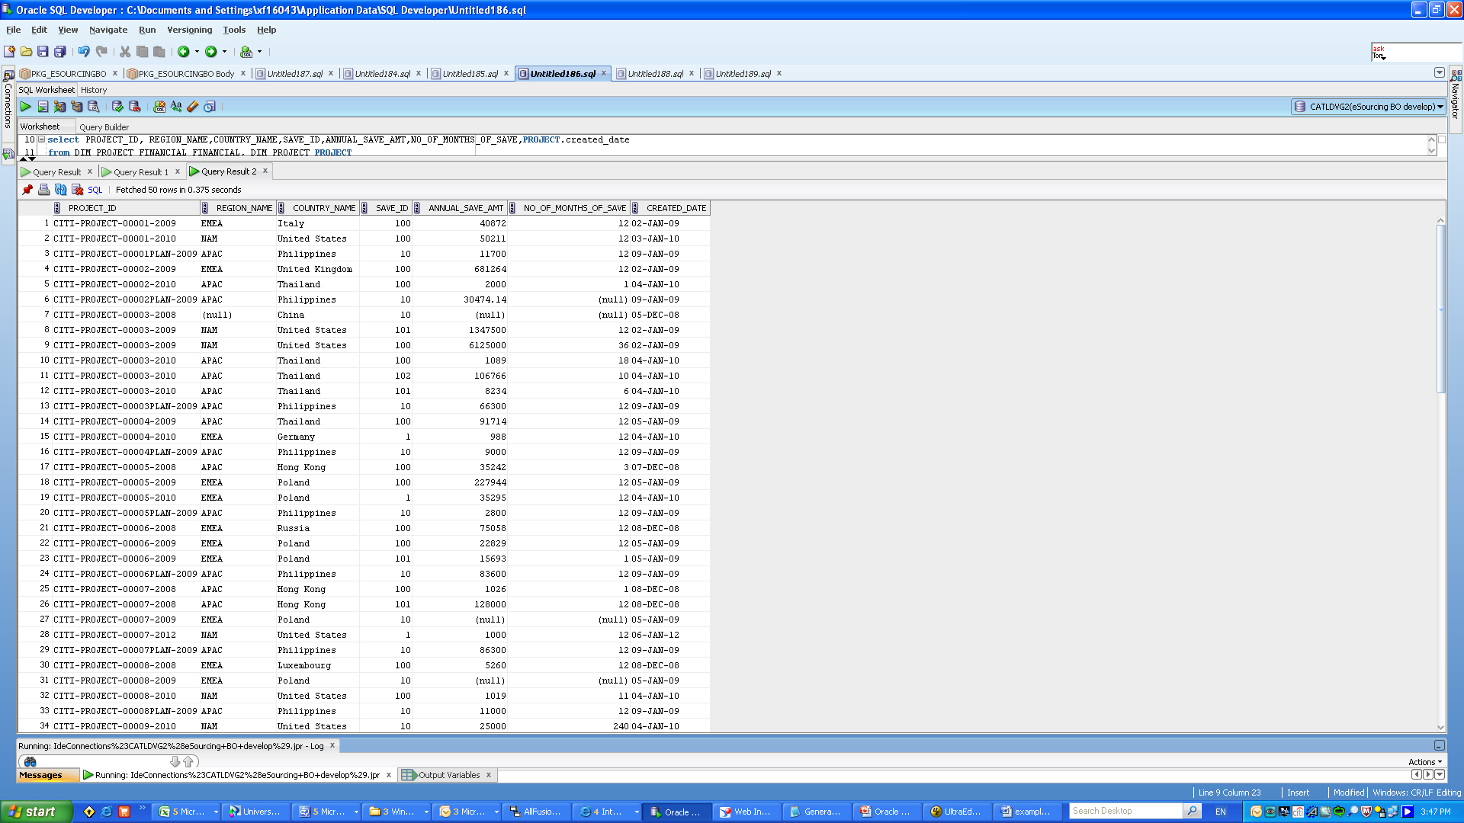

Slide 5
UR 1) sum ANNUAL_SAVE_AMT by project
2) sum ANNUAL_SAVE_AMT by country
3) sum ANNUAL_SAVE_AMT by region
SELECT PROJECT_ID,
REGION_NAME,
COUNTRY_NAME,
SAVE_ID,
SUM(ANNUAL_SAVE_AMT) SAVE,
SUM(SUM(ANNUAL_SAVE_AMT)) OVER(PARTITION BY PROJECT_ID) PROJECT,
SUM(SUM(ANNUAL_SAVE_AMT)) OVER(PARTITION BY COUNTRY_NAME) COUNTRY,
SUM(SUM(ANNUAL_SAVE_AMT)) OVER(PARTITION BY REGION_NAME) REGION
FROM DIM_PROJECT_FINANCIAL FINANCIAL,DIM_PROJECT PROJECT
WHERE
FINANCIAL.PROJECT_SOURCE_DOCUMENT_ID =PROJECT.PROJECT_SOURCE_DOCUMENT_ID
GROUP BY PROJECT_ID,
REGION_NAME,
COUNTRY_NAME,
SAVE_ID
ORDER BY PROJECT_ID;

Slide 6
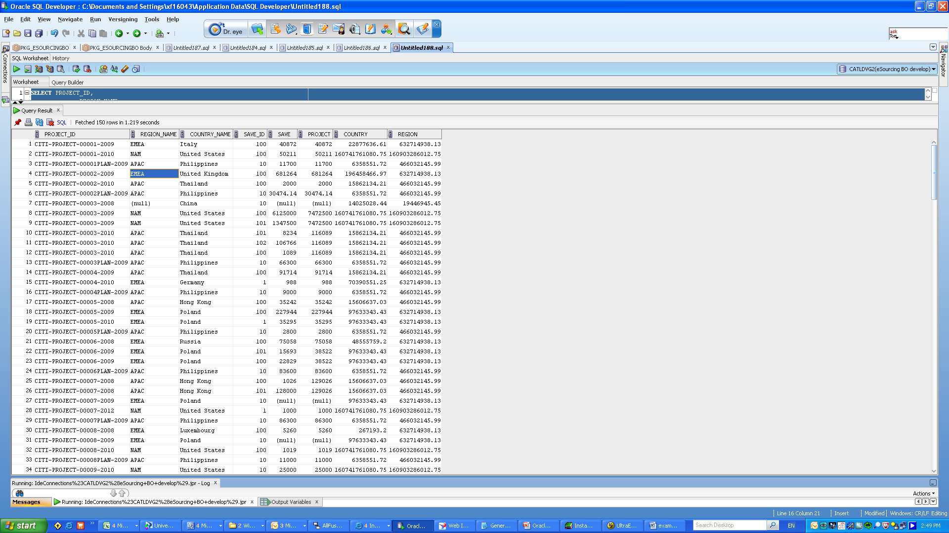

Slide 7
Q3: How to use <Partition-Clause>, <Over-by-Clause>, <Windowing Clause> ?
A3:Using one of these three clauses or all of them is up to circumstances.

Slide 8
UR 1) rank ANNUAL_SAVE_AMT by project
2) rank ANNUAL_SAVE_AMT by country
3) rank ANNUAL_SAVE_AMT by region
SELECT PROJECT_ID,
REGION_NAME,
COUNTRY_NAME,
SAVE_ID,
SUM(ANNUAL_SAVE_AMT) SAVE,
RANK () OVER(PARTITION BY PROJECT_ID ORDER BY SUM(ANNUAL_SAVE_AMT) DESC NULLS LAST) PROJECT_RANK,
RANK () OVER(PARTITION BY COUNTRY_NAME ORDER BY SUM(ANNUAL_SAVE_AMT) DESC NULLS LAST) COUNTRY_RANK,
RANK () OVER(PARTITION BY REGION_NAME ORDER BY SUM(ANNUAL_SAVE_AMT) DESC NULLS LAST) REGION_RANK
FROM DIM_PROJECT_FINANCIAL FINANCIAL,DIM_PROJECT PROJECT
WHERE
FINANCIAL.PROJECT_SOURCE_DOCUMENT_ID =PROJECT.PROJECT_SOURCE_DOCUMENT_ID
GROUP BY PROJECT_ID,
REGION_NAME,
COUNTRY_NAME,
SAVE_ID
ORDER BY PROJECT_ID;

Slide 9
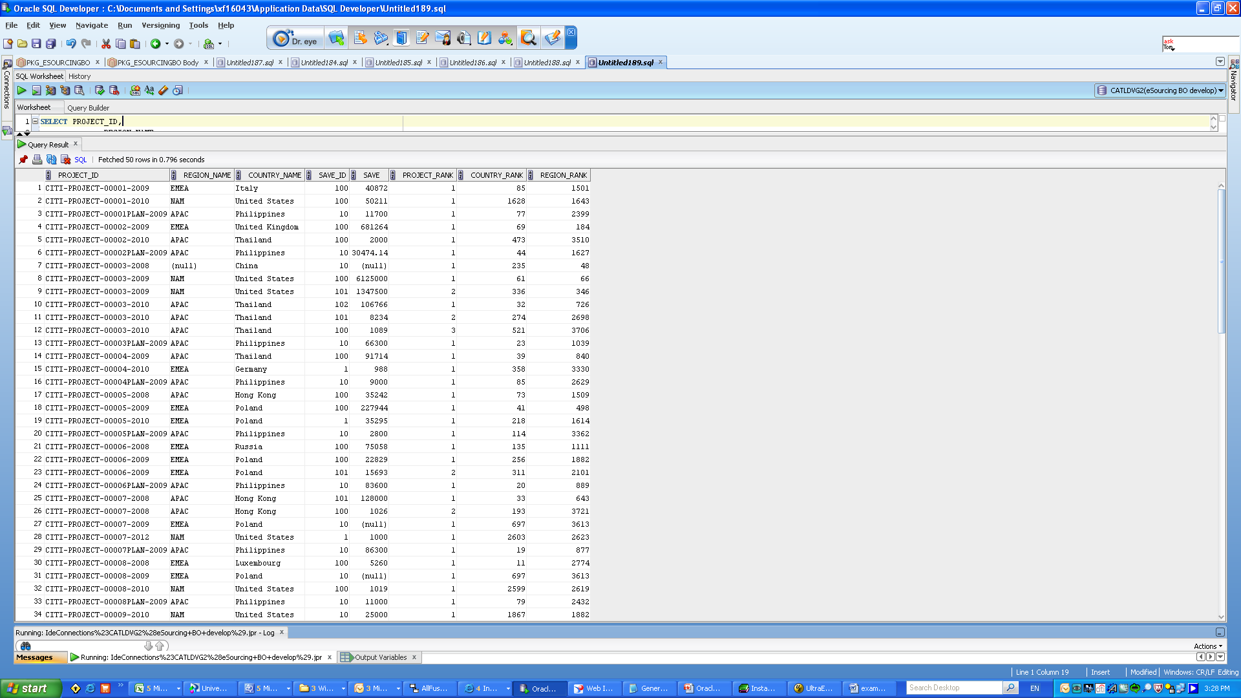

Slide 10
UR 1) sum ANNUAL_SAVE_AMT by region from the first time to current time
SELECT TO_CHAR(PROJECT.CREATED_DATE,’yyyy/mm/dd hh:mi:ss’),
REGION_NAME,
SUM(ANNUAL_SAVE_AMT) REGION_CURRENT_AMT,
SUM(SUM(ANNUAL_SAVE_AMT))
OVER(PARTITION BY REGION_NAME
ORDER BY PROJECT.CREATED_DATE NULLS LAST
ROWS BETWEEN UNBOUNDED PRECEDING AND CURRENT ROW) REGION_AGGREGATE
FROM DIM_PROJECT_FINANCIAL FINANCIAL,DIM_PROJECT PROJECT
WHERE
FINANCIAL.PROJECT_SOURCE_DOCUMENT_ID =PROJECT.PROJECT_SOURCE_DOCUMENT_ID
GROUP BY PROJECT.CREATED_DATE,
REGION_NAME
ORDER BY PROJECT.CREATED_DATE;

Slide 11
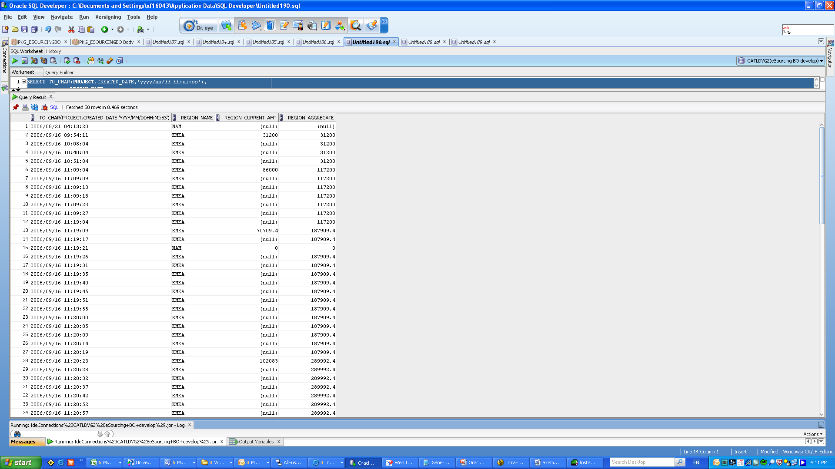

Slide 12
NOW we know something about OVER()
LET US GET MORE:
FIVE TYPES FUNCTION WITH OVER()
RANKING
WINDOWING
LAG &LEAD
REPORTING
LINEAR REGRESSION

Slide 13
RANKING
RANK , DENSE_RANK, ROW_NUMBER,CUME_DIST and so on
SELECT
REGION_NAME,
COUNTRY_NAME,
--SAVE_ID,
--SUM(ANNUAL_SAVE_AMT)
SUM(NO_OF_MONTHS_OF_SAVE),
RANK() OVER(PARTITION BY REGION_NAME ORDER BY SUM(NO_OF_MONTHS_OF_SAVE) NULLS LAST) RANK,
DENSE_RANK() OVER(PARTITION BY REGION_NAME ORDER BY SUM(NO_OF_MONTHS_OF_SAVE) NULLS LAST) DENSE_RANK,
ROW_NUMBER() OVER(PARTITION BY REGION_NAME ORDER BY SUM(NO_OF_MONTHS_OF_SAVE) NULLS LAST) ROW_NUMBER
FROM DIM_PROJECT_FINANCIAL FINANCIAL,DIM_PROJECT PROJECT
WHERE
FINANCIAL.PROJECT_SOURCE_DOCUMENT_ID =PROJECT.PROJECT_SOURCE_DOCUMENT_ID
GROUP BY REGION_NAME,COUNTRY_NAME
ORDER BY REGION_NAME

Slide 14
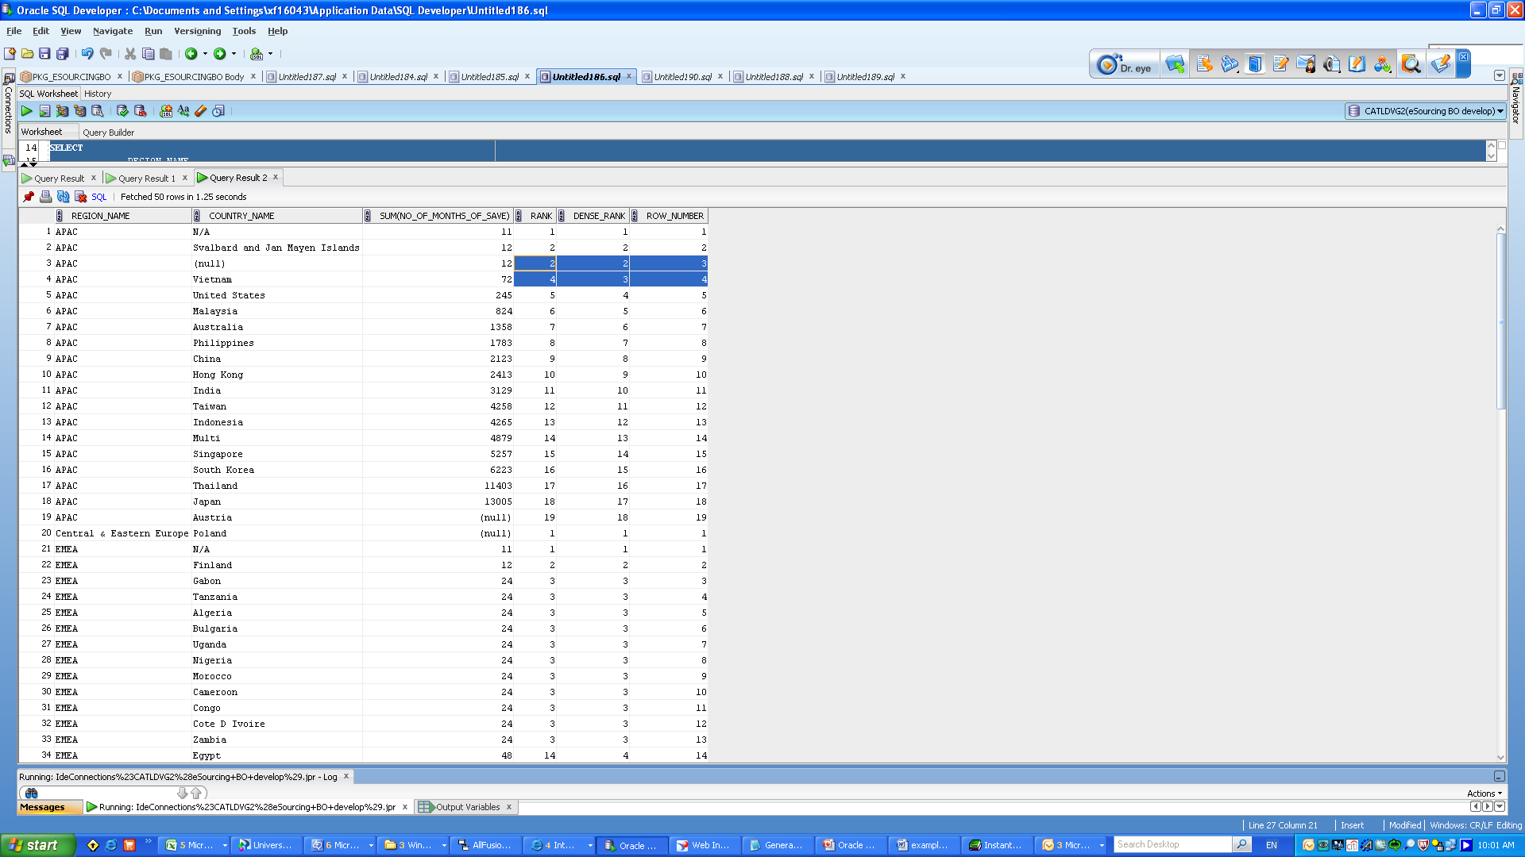

Slide 15
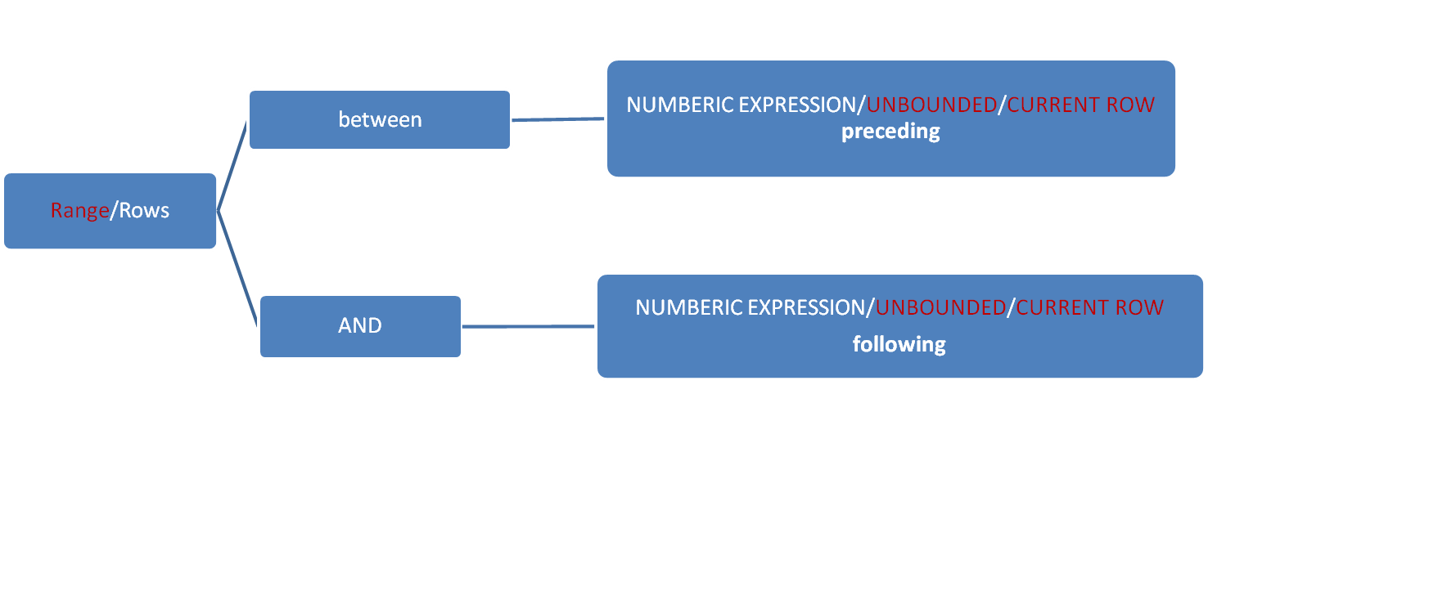
2. WINDWING
SUM, COUNT, AVG,MIN,MAX,FIRST_VALUE……OVER(ORDER-BY-CLAUSE
)
Tips: Range , Rows And Range for Multi-order-by-clause

Slide 16
Range for Multi-order-by-clause
SELECT TO_CHAR(PROJECT.CREATED_DATE,'yyyy/mm/dd hh:mi:ss'),
REGION_NAME,
SUM(ANNUAL_SAVE_AMT) REGION_CURRENT_AMT,
SUM(SUM(ANNUAL_SAVE_AMT))
OVER(PARTITION BY REGION_NAME
ORDER BY PROJECT.CREATED_DATE,SUM(ANNUAL_SAVE_AMT) NULLS LAST
RANGE BETWEEN unbounded preceding AND current row) REGION_AGGREGATE
FROM DIM_PROJECT_FINANCIAL FINANCIAL,DIM_PROJECT PROJECT
WHERE
FINANCIAL.PROJECT_SOURCE_DOCUMENT_ID =PROJECT.PROJECT_SOURCE_DOCUMENT_ID
GROUP BY PROJECT.CREATED_DATE,
REGION_NAME
ORDER BY PROJECT.CREATED_DATE;

Slide 17
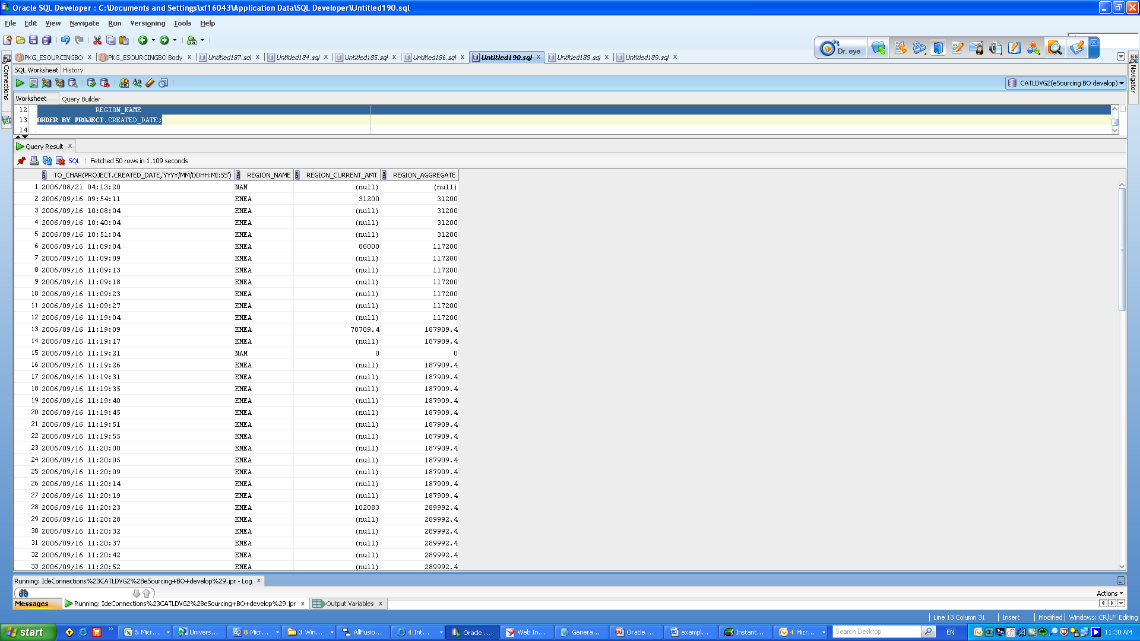

Slide 18
3. LAG & LEAD
LAG , LEAD And so on
SELECT TO_CHAR(PROJECT.CREATED_DATE,'yyyy/mm/dd hh:mi:ss'),
REGION_NAME,
SUM(ANNUAL_SAVE_AMT) REGION_CURRENT_AMT,
LAG(SUM(ANNUAL_SAVE_AMT),2)
OVER( ORDER BY PROJECT.CREATED_DATE,SUM(ANNUAL_SAVE_AMT) NULLS LAST
) REGION_AGGREGATE
FROM DIM_PROJECT_FINANCIAL FINANCIAL,DIM_PROJECT PROJECT
WHERE
FINANCIAL.PROJECT_SOURCE_DOCUMENT_ID =PROJECT.PROJECT_SOURCE_DOCUMENT_ID
GROUP BY PROJECT.CREATED_DATE,
REGION_NAME
ORDER BY PROJECT.CREATED_DATE;

Slide 19
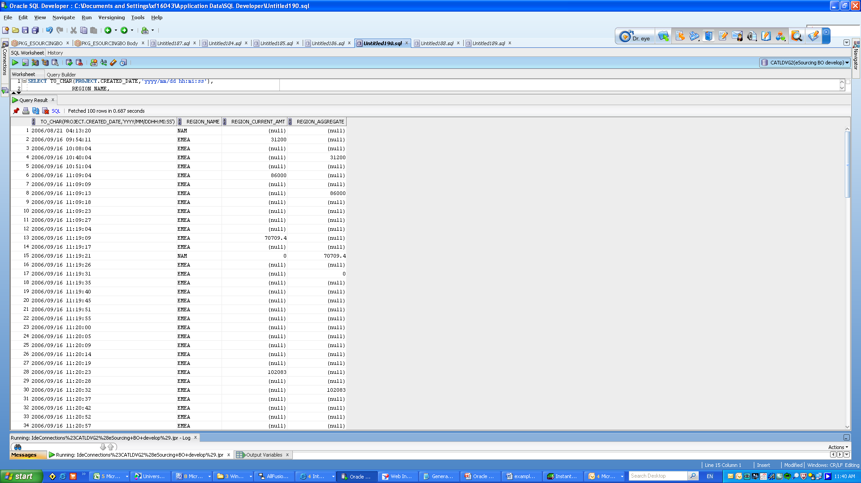

Slide 20
4. REPORTING
RATIO_TO_REPORT And so on
RATIO_TO_REPORT(SUM(COLUMN)) OVER(<PARTITION-BY-CLAUSE>)
= SUM(COLUMN)/(SUM(SUM(COLUMN)) OVER(<PARTITION-BY-CLAUSE>))

Slide 21
5. LINEAR REGRESSION
REGR_SLOPE, REGR_AVGX,REGR_AVGY and so on

Slide 22
Q & A

